Slide 1

Smart Fire Safety & Automatic Water Response System
Presented by:
Amna Khalid
Hiba Fatima
Malaika Arshad
Submitted to: Sir Nasir Mehmood

Slide 2

OVERVIEW
Introduction to Smart Fire Safety
IoT-Based System
Multi-Sensor Detection
Leveraging the power of the Internet of Things (IoT) for enhanced fire detection and prevention capabilities.
Integrates smoke, flame, and temperature sensors for comprehensive threat identification.
Automated Response
Initiates automatic water suppression and immediate alert notifications for rapid intervention.

Slide 3




THE CHALLENGE
Addressing Critical Fire Safety Gaps
Traditional fire safety systems often fall short in critical areas, leading to increased risks and potential for significant damage. Our project aims to solve these prevalent issues:
Late Fire Detection
Manual or older systems often delay critical detection, wasting precious time.
No Automatic Response
Lack of immediate, automated suppression means fires can escalate quickly.
No Real-time Monitoring
Absence of continuous oversight leaves gaps in safety surveillance.
Manual Fire Control
Reliance on human intervention increases response times and risk.

Slide 4

OUR GOALS
Key Objectives for Enhanced Safety
Our project is designed with specific, measurable objectives to deliver a robust and responsive fire safety solution.
1
2
Detect Fire and Smoke
Automatic Pump Activation
Accurately identify the presence of fire and smoke using advanced sensors.
Instantly activate a water pump for immediate suppression efforts.
3
4
Real-Time IoT Monitoring
Emergency Alerts
Provide continuous, remote monitoring of environmental conditions via IoT.
Send instant notifications to relevant personnel or authorities in case of an incident.

Slide 5

THE SOLUTION
Intelligent Fire Safety with ESP32
Our proposed solution leverages the power of the ESP32 microcontroller to create an integrated and responsive fire safety system.
Continuous Monitoring
Instant Response
Cloud Connectivity
The ESP32 constantly reads data from all connected sensors.
Upon detection of danger, it triggers the buzzer and activates the water pump.
Emergency alerts are immediately sent to the Blynk cloud for remote access and notifications.

Slide 6
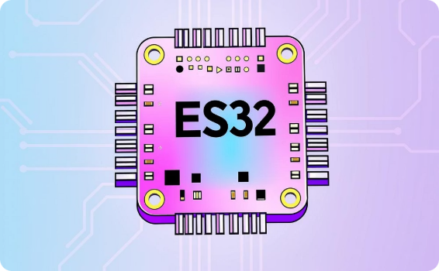






COMPONENTS
Essential Hardware for System Functionality
The core of our fire safety system relies on a selection of robust and reliable hardware components.
ESP32 Microcontroller
MQ-2 Gas Sensor
Flame Sensor
DHT11 Sensor
The central processing unit for data collection and system control.
Detects flammable gases and smoke concentrations.
Identifies the presence of fire through infrared light detection.
Monitors ambient temperature and humidity levels.
Relay Module
Water Pump
Buzzer
Controls the water pump, acting as an electronic switch.
Disperses water for fire suppression.
Provides an audible alarm for immediate local warning.

Slide 7




TOOLS
Software for Development and Monitoring
Our project utilizes industry-standard software tools for efficient development, simulation, and real-time data visualization.
Visual Studio Code
Wokwi Simulator
Blynk IoT Platform
The primary IDE for coding the ESP32 microcontroller with extensions for Arduino or PlatformIO.
An online platform for simulating electronics projects, allowing for testing and debugging without physical hardware.
A user-friendly IoT platform for creating custom dashboards and receiving real-time alerts from the device.

Slide 8





PROCESS
System Operation Flowchart
This flowchart illustrates the sequential steps and decision-making process within our Smart Fire Safety System, from initialization to continuous monitoring.
Fire Detected?
Decision: trigger actions
Read Sensors
Obtain current values
Initialize ESP32
Boot sensors and network
Start
Begin system operation

Slide 9
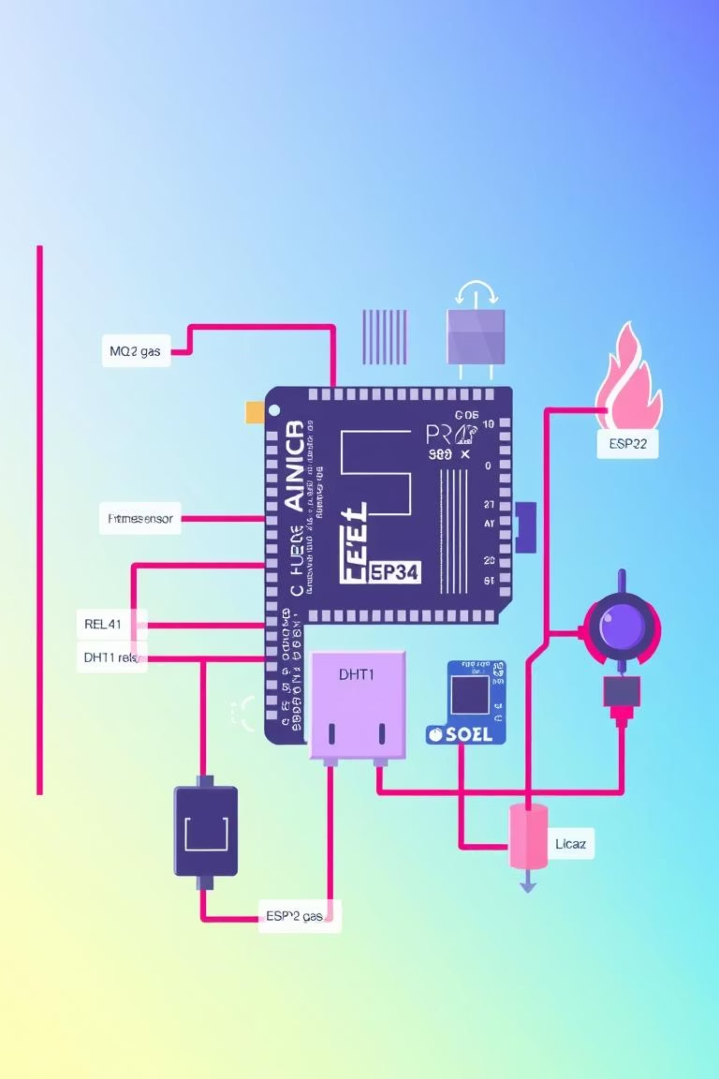
ARCHITECTURE
Circuit Diagram: Graphical View
This diagram visually represents the interconnections between the ESP32 and various sensors, actuators, and power components, forming the complete fire safety system.

Slide 10

BENEFITS
Key Advantages of Our System
Our Smart Fire Safety and Automatic Water Response System offers significant benefits, enhancing safety and peace of mind.
Early Fire Detection
Minimizes damage and ensures quick response by detecting threats at the earliest stages.
Automated Response
Eliminates human error and delays with immediate water suppression and alert triggering.
Cost-Effective Solution
Reduces potential losses from fire incidents and offers an affordable setup compared to complex industrial systems.
Smart IoT Integration
Provides remote monitoring, control, and notifications for comprehensive smart safety management.

Slide 11




🚀 Future Scope: Advancing Intelligent Fire Protection
The potential for enhancing fire safety systems through integration and artificial intelligence is vast. Our roadmap includes several key developments to create more responsive and interconnected solutions.
Mobile App Integration
GSM-Based SMS Alerts
AI-Based Detection
Develop a dedicated mobile application for real-time monitoring, remote control, and instant notifications to users.
Implement GSM module integration for sending crucial SMS alerts to designated contacts during emergencies.
Integrate advanced AI algorithms for more sophisticated fire pattern recognition and reduced false alarms.

Slide 12




🏁 Conclusion: A Step Towards Smarter Fire Safety
Reliable Fire Safety
Reduced Human Intervention
Our system delivers robust and reliable fire detection and suppression, minimizing risks and protecting assets.
Automated responses decrease reliance on manual action, ensuring faster and more consistent safety measures.
Versatile Applications
Designed for adaptability, the system is ideal for homes, laboratories, and diverse industrial environments.

